Slide 1
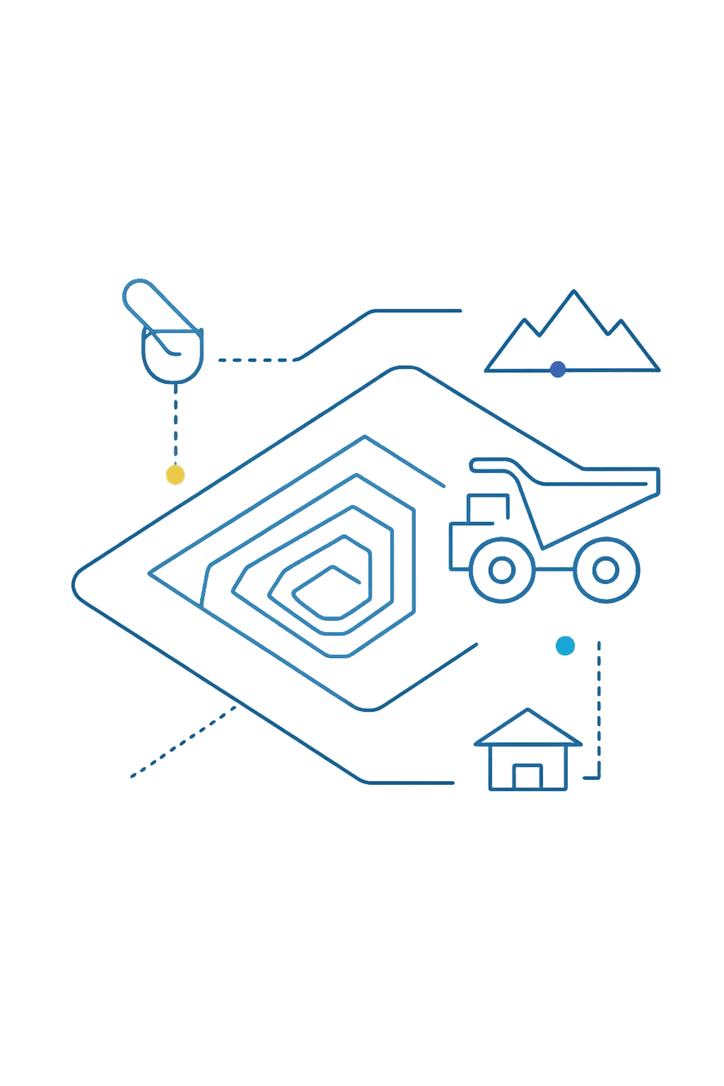
MineWatch
Automated Detection and Temporal Tracking of Illegal Mining Using Sentinel-2 Satellite Imagery and Deep Learning
Team No. 04 | Bennett University | April 2026
Rishi Ranjan (S24CSEU0327)
Rohit Bansal (S24CSEU0292)
Pragya Khokhar (S24CSEU2550)
Riya Maurya (S24CSEU0347)

Slide 2

The Problem
Illegal mining operations cause severe environmental damage across India
Traditional ground-based monitoring remains slow, costly, and manual, making it impractical for widespread surveillance. Remote and inaccessible locations further complicate survey efforts, creating enforcement gaps.
Until now, no automated solution leveraged freely available satellite imagery to systematically track mining activity over time.

Slide 3
MineWatch — Our Solution
EfficientNet-B0 Classifier
Sliding Window Inference
Flask Web Application
State-of-the-art deep learning architecture optimized for satellite image classification
Process full satellite tiles systematically with overlapping patches for comprehensive coverage
End-to-end platform: upload imagery, analyse automatically, generate reports
92.79%
100%
5
Model Accuracy
Free Imagery
Years Tracked
Sentinel-2 data
2021–2025

Slide 4
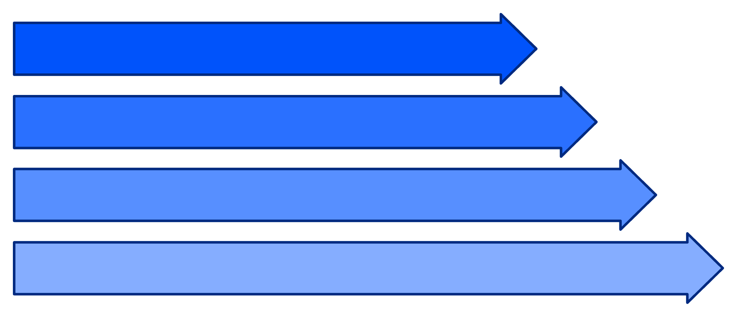
Dataset & System Pipeline
Dataset Specifications
11,600 patches (64×64 pixels) from 5 Indian mining sites
Tile T45QUE covering key regions
Time period: 2021–2025
Preprocessed using QGIS
JP2 Input
Preprocessing
Training Distribution
EfficientNet-B0
Training: 2,068 patches | Validation: 443 patches | Test: 444 patches
Overlay & Reports
Binary classification: Mining (0) vs Non-Mining (1)

Slide 5





System Methodology
Stage 1 — Satellite Input
Sentinel-2 JP2 tile
10m resolution, RGB bands
Stage 2 — Patch Extraction
64×64px sliding window
Stride = 32px (50% overlap)
~29,000 patches per scene
Stage 3 — 6 Models Trained & Compared
Custom CNN
Enhanced CNN
ResNet-18
MobileNetV2
EfficientNet-B0
EfficientNetV2-S
Stage 4 — Benchmarking & Selection
Test set: 444 patches
Best model selected on Accuracy + F1
Winner: EfficientNet-B0 (92.79%)
Stage 5 — Output
Red overlay map
Probability heatmap
GPS coordinates CSV

Slide 6

6-Model Benchmark Comparison
Model
Accuracy
AUC-ROC
F1 Score
Custom CNN
91.67%
0.9741
0.88
Enhanced CNN
92.57%
0.9785
0.92
ResNet-18
91.89%
0.9738
0.89
MobileNetV2
92.12%
0.9734
0.90
EfficientNet-B0
92.79%
0.9711
0.94
EfficientNetV2-S
92.79%
0.9756
0.94
Champion Model: EfficientNet-B0 achieves best accuracy and F1 score with only 5.3M parameters — optimal balance of performance and efficiency

Slide 7
How We Compare to Published Work
Study
Method
Accuracy
Balaniuk et al. (2020)
FCNN + Sentinel-2
Not reported
Yesilmen et al. (2022)
DenseNet/ResNet
~90%
AFSA-SVM (2022)
SVM hybrid
90.6%
Ours — MineWatch
EfficientNet-B0
92.79%
First EfficientNet Benchmark
Beats Published Work
Free Imagery Pipeline
Superior to all comparable published methods with 92.79% accuracy
End-to-end system using 100% freely available Sentinel-2 data
First published EfficientNet architecture evaluation for Indian mining site detection

Slide 8
MineWatch Web Application
HTML + CSS + JavaScript
Flask + Python
EfficientNet-B0
Front-end framework
Back-end API
Core classifier
Dashboard
Upload & Analyse
Real-time metrics and trend visualizations
JP2 file upload with automatic year detection
Results Map
Temporal Analysis
Red overlay and heatmap visualization
2021–2025 expansion tracking
Site Report
Model Comparison
Risk assessment with CSV download
All 6 architecture benchmarks

Slide 9
Conclusion & Future Work
Conclusion
Future Work
92.79% accuracy, surpassing published benchmarks
5-year temporal tracking across 5 Indian mining sites
End-to-end deployable pipeline using free imagery
Semi-supervised learning on 8,600 unlabelled patches
NIR Band 8 for enhanced spectral discrimination
Automated cloud mask filtering integration
Government portal deployment
92.79%
5
5
Model Accuracy
Years Tracked
Indian Sites
2021–2025
Monitored locations

